Slide 1
Java Programming, 9e Chapter 9
Advanced Array Concepts

Slide 2
Objectives
Sort array elements using the bubble sort algorithm
Sort array elements using the insertion sort algorithm
Use two-dimensional and other multidimensional arrays
Use the Arrays class
Use the ArrayList class
Create enumerations

Slide 3
Sorting Array Elements Using the Bubble Sort Algorithm (1 of 2)
Sorting
The process of arranging a series of objects in some logical order
Ascending order
Begin with the object that has the lowest value
Descending order
Begin with the object that has the largest value

Slide 4
Sorting Array Elements Using the Bubble Sort Algorithm (2 of 2)
Simplest possible sort
Involves two values that are out of order
Swap two values (assume valA = 16 and valB = 2)
temp = valA; // 16 goes to temp
valA = valB; // 2 goes to valA
valB = temp; // 16 goes to valB

Slide 5
Using the Bubble Sort Algorithm (1 of 3)
Bubble sort
You continue to compare pairs of items, swapping them if they are out of order
The smallest items “bubble” to the top of the list, eventually creating a sorted list

Slide 6
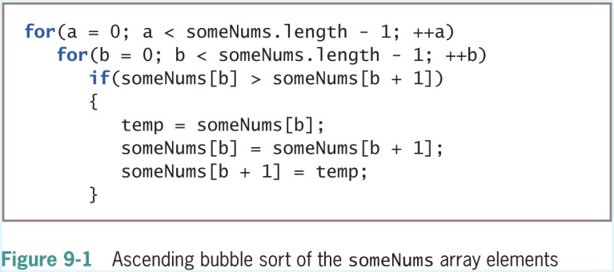
Using the Bubble Sort Algorithm (2 of 3)

Slide 7
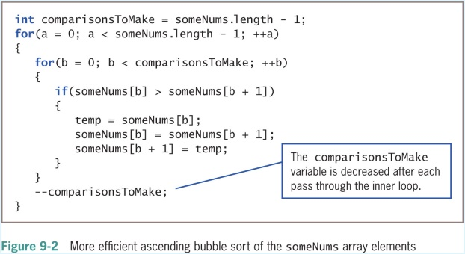
Using the Bubble Sort Algorithm (3 of 3)

Slide 8
Sorting Arrays of Objects
You can sort arrays of objects in much the same way that you sort arrays of primitive types
Major difference
Make the comparison that determines whether to swap two array elements
Sort based on a particular object field

Slide 9
Sorting Array Elements Using the Insertion Sort Algorithm (1 of 2)
Insertion sort
A sorting algorithm that enables you to look at each list element one at a time
Move items down if the tested element should be inserted prior to other elements
Similar to the technique that sorts a group of objects manually

Slide 10
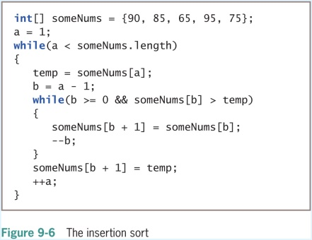
Sorting Array Elements Using the Insertion Sort Algorithm (2 of 2)

Slide 11
Using Two-Dimensional and Other Multidimensional Arrays (1 of 3)
One-dimensional or single-dimensional array
An array that you can picture as a column of values
Elements are accessed using a single subscript
Two-dimensional arrays
Have two or more columns of values
Have rows and columns
Use two subscripts
Are often called a matrix or table
int[][] someNumbers = new int[3][4];

Slide 12
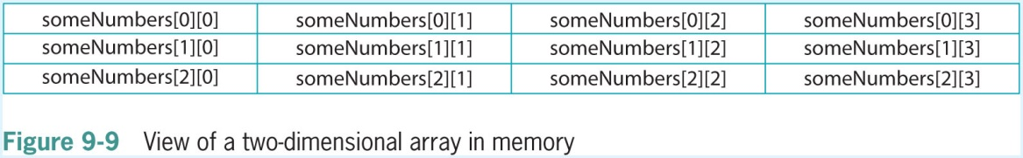
Using Two-Dimensional and Other Multidimensional Arrays (2 of 3)

Slide 13
Using Two-Dimensional and Other Multidimensional Arrays (3 of 3)
int[][] rents = { {400, 450, 510},
{500, 560, 630},
{625, 676, 740},
{1000, 1250, 1600} };

Slide 14
Passing a Two-Dimensional Array to a Method
Pass the array name just as you do with a one-dimensional array
public static void displayScores(int[][]scoresArray)

Slide 15
Using the length Field with a Two-Dimensional Array
The length field holds the number of rows in the array
rents.length
Each row has a length field that holds the number of columns in the row
rents[1].length

Slide 16
Understanding Jagged Arrays
Jagged array (ragged array)
A two-dimensional array with rows of different lengths
To create a jagged array:
Define the number of rows for a two-dimensional array
Do not define the number of columns in the rows
Then declare the individual rows

Slide 17
Using Other Multidimensional Arrays
Multidimensional arrays
Arrays with more than one dimension
Create arrays of any size
Keep track of the order of variables needed as subscripts
Do not exhaust your computer’s memory

Slide 18
Using the Arrays Class (1 of 4)
Arrays class
Contains many useful methods for manipulating arrays
static methods
Use them with the class name without instantiating an Arrays object
binarySearch() method
A convenient way to search through sorted lists of values of various data types
The list must be in order

Slide 19
Using the Arrays Class (2 of 4)
Table 9-2 Useful methods of the Arrays class
Method | Purpose
static int binarySearch(type[] a, type key) | Searches the specified array for the specified key value using the binary search algorithm
static boolean equals(type[] a, type[] a2) | Returns true if the two specified arrays of the same type are equal to one another
static void fill(type[] a, type val) | Assigns the specified value to each element of the specified array
static void sort(type[] a) | Sorts the specified array into ascending order
static void sort(type[] a, int fromIndex, int toIndex) | Sorts the specified range of the array into ascending order
static void parallelSort(type[] a) | Sorts the specified array into ascending order
static void parallelSort(type[] a, int fromIndex, int toIndex) | Sorts the specified range of the array into ascending order

Slide 20
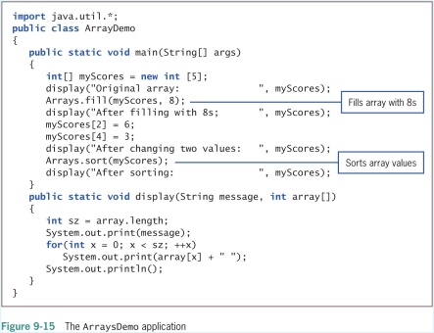
Using the Arrays Class (3 of 4)

Slide 21
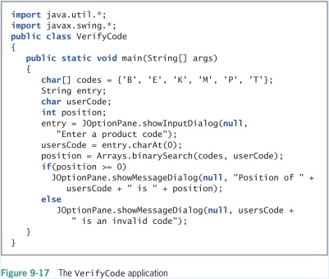
Using the Arrays Class (4 of 4)

Slide 22
Using the ArrayList Class (1 of 3)
The ArrayList class provides some advantages over the Arrays class
Dynamically resizable
Can add an item at any point in an ArrayList container
Can remove an item at any point in an ArrayList container
Capacity
The number of items an ArrayList can hold without having to increase its size

Slide 23
Using the ArrayList Class (2 of 3)
Table 9-3 Useful methods of the ArrayList class
Method | Purpose
public void add(Object) public void add(int, Object) | Adds an item to an ArrayList; the default version adds an item at the next available location; an overloaded version allows you to specify a position at which to add the item
public void remove(int) | Removes an item from an ArrayList at a specified location
public void set(int, Object) | Alters an item at a specified ArrayList location
Object get(int) | Retrieves an item from a specified location in an ArrayList
Public int size() | Returns the current ArrayList size

Slide 24
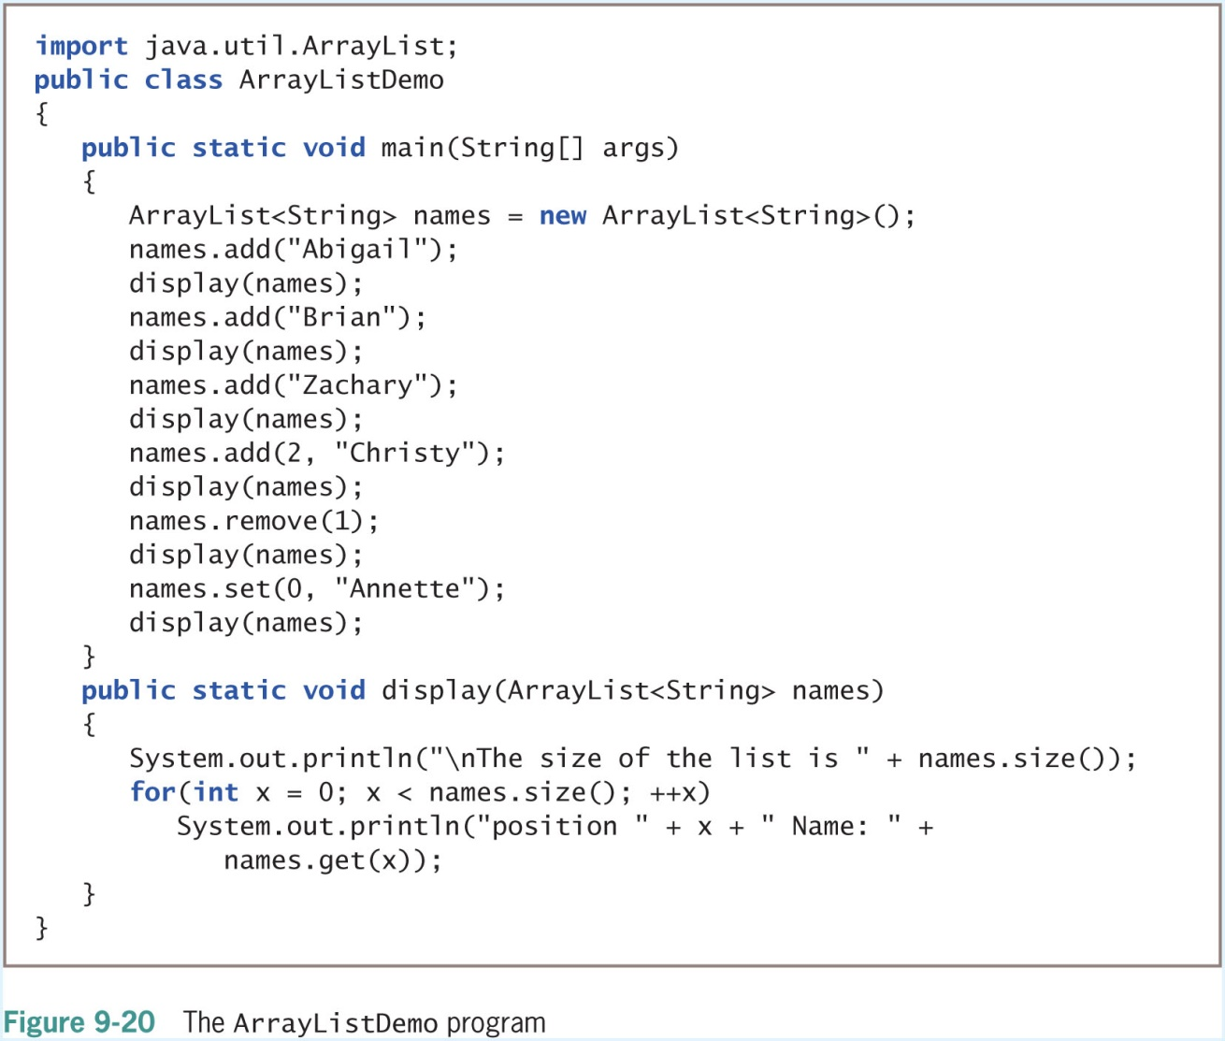
Using the ArrayList Class (3 of 3)

Slide 25
Creating Enumerations (1 of 7)
Enumerated data type
A programmer-created data type with a fixed set of values
To create an enumerated data type, use:
The keyword enum
An identifier for the type
A pair of curly braces that contain a list of the enum constants
enum Month {JAN, FEB, MAR, APR, MAY, JUN,
JUL, AUG, SEP, OCT, NOV, DEC};

Slide 26
Creating Enumerations (2 of 7)
Table 9-4 Some useful nonstatic enum methods
Method | Description | Example if mon = Month.MAY
toString() | Returns the name of the calling constant object | mon.toString() is "MAY"
ordinal() | Returns an integer that represents the constant’s position in the list of constants; as with arrays, the first position is 0 | mon.ordinal() is 4
equals() | Returns true if its argument is equal to the calling object’s value | mon.equals(Month.MAY) is true mon.equals(Month.NOV) is false
compareTo() | Returns a negative integer if the calling object’s ordinal value is less than that of the argument, 0 if they are the same, and a positive integer if the calling object’s ordinal value is greater than that of the argument | mon.compareTo(Month.JUL) is negative mon.compareTo(Month.FEB) is positive mon.compareTo(Month.MAY) is 0

Slide 27
Creating Enumerations (3 of 7)
Table 9-5 Some static enum methods
Method | Description | Example with Month Enumeration
valueOf() | Accepts a string parameter and returns an enumeration constant | Month.valueOf("DEC") returns the DEC enum constant
values() | Returns an array of the enumerated constants | Month.values() returns an array with 12 elements that contain the enum constants

Slide 28
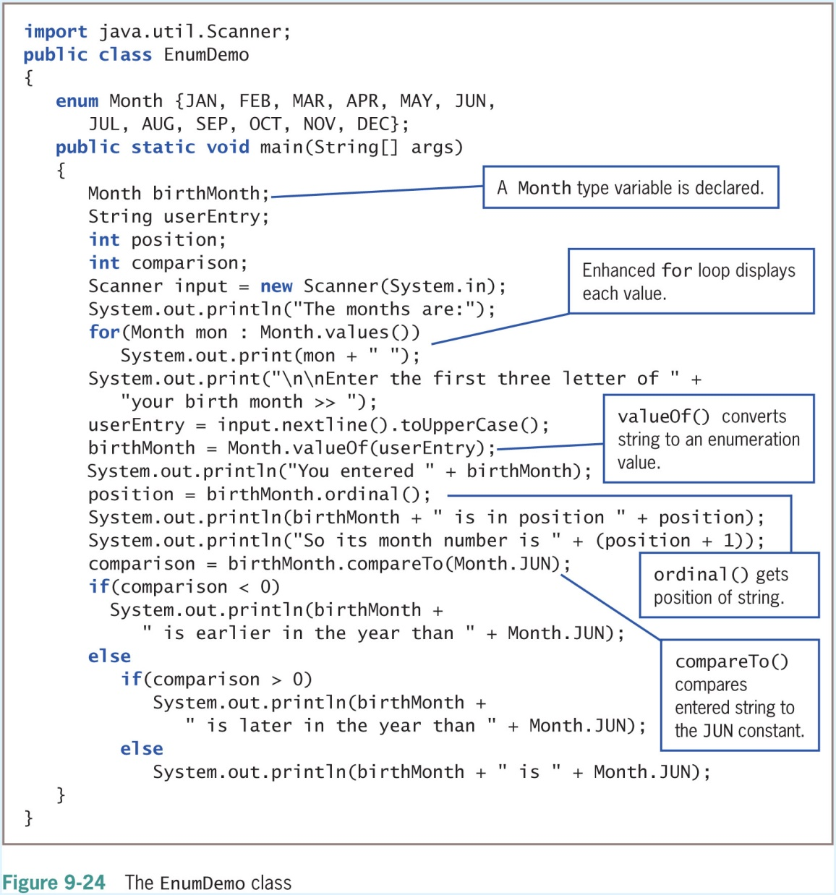
Creating Enumerations (4 of 7)

Slide 29
Creating Enumerations (5 of 7)
You can declare an enumerated type in its own file
Filename matches the type name and has a .java extension
You can use comparison operators with enumeration constants
You can use enumerations to control a switch structure

Slide 30
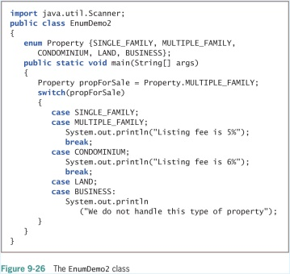
Creating Enumerations (6 of 7)

Slide 31
Creating Enumerations (7 of 7)
Advantages of creating an enumeration type:
Only allowed values can be assigned
Using enums makes the values type-safe
Provides a form of self-documentation
You can also add methods and other fields to an enum type
Type-safe
Describes a data type for which only appropriate behaviors are allowed

Slide 32
Don’t Do It
Don’t forget that the first subscript used with a two-dimensional array represents the row, and that the second subscript represents the column
Don’t try to store primitive data types in an ArrayList structure
Don’t think enum constants are strings; they are not enclosed in quotes

Slide 33
Summary
Sorting
The process of arranging a series of objects in some logical order
Bubble sort and Insertion sort
Two-dimensional arrays
Both rows and columns
Arrays class
ArrayList class
A programmer-created data type with a fixed set of values is an enumerated data type

